Slide 1
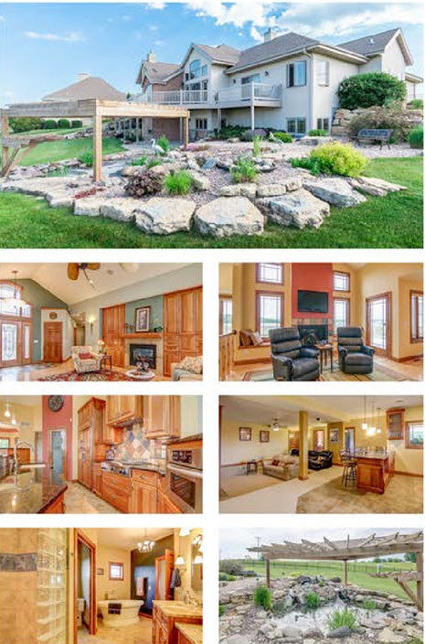
Choose a Real Estate Cover Photo

Slide 2
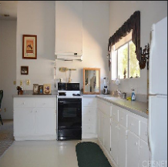
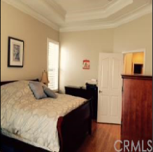
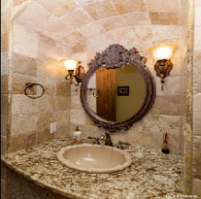
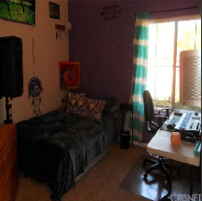
Project Goal
Help to pick the best cover photo for real estate online listing

Slide 3
Data
Contains 2,140 images and price.
4 images for each house : bedroom, bathroom, kitchen and a frontal image of the house.
Sample houses from the state of California, USA.

Slide 4
Methods

Slide 5
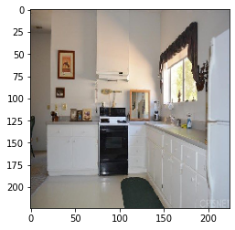
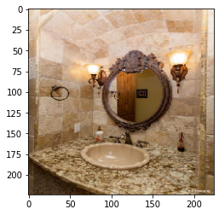
Results
true price: $400,000.00
predicted: $406,488.83
true price: $865,200.00
predicted: $429,759.28

Slide 6
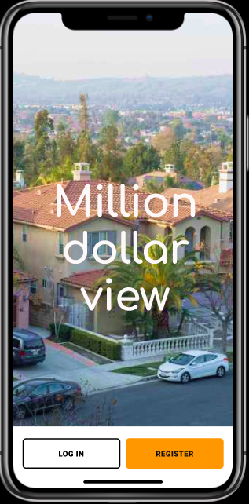

Implementation
Phone Application
Integrated Technology

Slide 7
Future Work
Gather more data
Arrange pictures in order ( from the most ”expensive” to the “cheapest”)
Give users advice how to make selected images look better

Slide 8
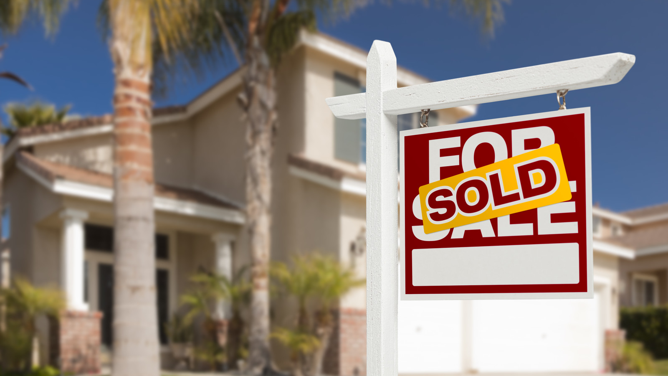
Thank You !

